Slide 1


CREATING TABLES
IN SQL
- NEHA PRASAD

Slide 2
INTRODUCTION
SQL tables are where all your data lives. They’re like spreadsheets with rows and columns, but much more powerful
Introduction to SQL Tables
SQL tables are essential components of a relational database. They store data in a structured format and play a crucial role in database management. Creating tables with the right structure is vital for efficient data storage and retrieval.
FULL SERVICE AGENCY
WWW.ELEMENTS.COM
01

Slide 3

Syntax for Creating Tables
To create a table in SQL, use the command: CREATE TABLE. The syntax includes specifying the table name, column names, data types for each column, and any constraints.
For example:
CREATE TABLE table_name (
column1 datatype,
column2 datatype,
...
);

Slide 4
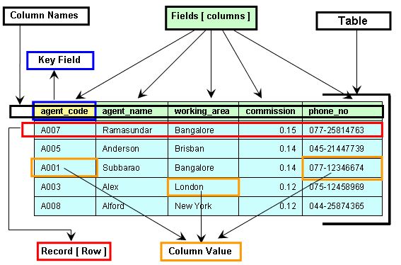
Defining Table Structure
When creating a table, define the structure by specifying the columns it will contain. Each column should have a data type (e.g., INT, VARCHAR, DATE) that determines the kind of data it can store. Additionally, consider using constraints like NULL or NOT NULL to ensure data integrity.

Slide 5

Adding Constraints
Constraints in SQL tables enforce rules and relationships between data. Common constraints include PRIMARY KEY (uniquely identifies each record), FOREIGN KEY (establishes a link between tables), UNIQUE (ensures values are unique), and CHECK (defines conditions for column values).

Slide 6
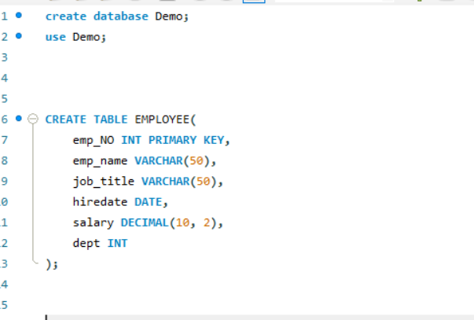
Example of Creating Tables
Let's create a sample table:
In this example, we create an "employees" table with columns for employee no, emploee name, job title, hire date,salary and department.

Slide 7

Best Practices for Table Creation
Designing tables effectively involves normalization to minimize redundancy and ensure data integrity. Follow best practices such as avoiding duplicate data, organizing data logically, and using appropriate data types to optimize performance and maintain a well-structured database.

Slide 8

Conclusion
Creating tables in SQL is a fundamental aspect of database management. By understanding the syntax, structure, and constraints, you can build tables that store data efficiently and support effective database operations.

Slide 9

Thank you for your attention. Creating tables in SQL is a foundational skill in database management that can significantly impact the performance and usability of databases.
THANKS!

